Slide 1
Object Detection
Cynthia Lu, Kristen Mast, Max Spieler
Ruisen Tu, Owen Kelley

Slide 2
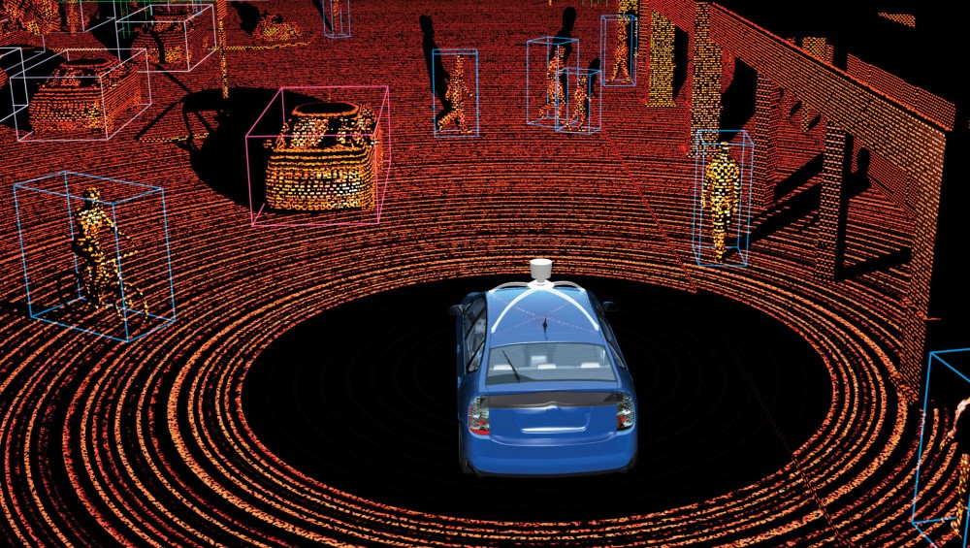
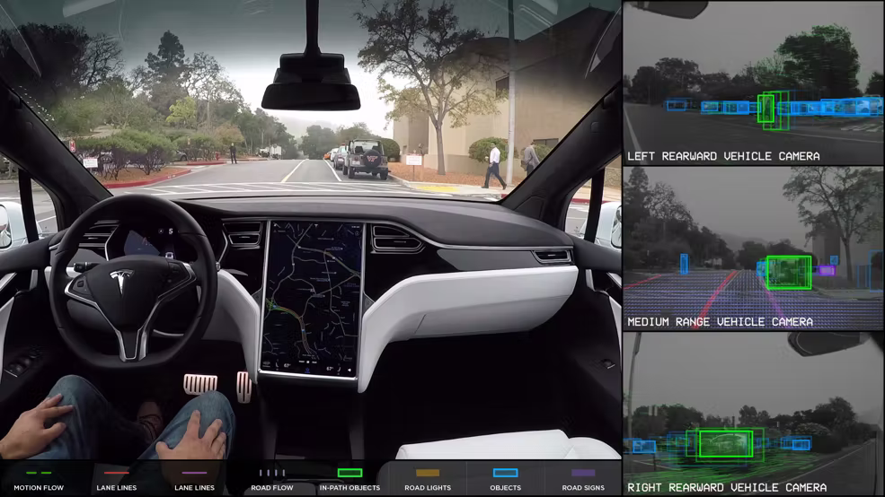
Overview - History
Convolutional Neural Nets ( > LiDAR)
In the past LiDAR was used ($$$)
Lots of issues “seeing” in the rain
Notes:
Owen - LiDAR “sees” distances and change in speed - Convolutional Neural Net “actually sees” signs, people, cars

Slide 3
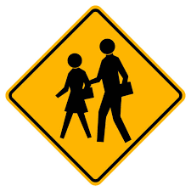
Goal & Methodology
Goal - What
Have cars “see” their surroundings, differentiate between and recognize different objects
Methodology - How
Training Convolutional Neural Network to classify cars, signs, pedestrians
Reason - Why
Traditional methods (LiDAR) were too expensive for commercial use
1.35 million people die annually from car accidents
https://www.asirt.org/safe-travel/road-safety-facts/
Notes:
Owen - Large majority of annual deaths are pedestrian

Slide 4
Process
Model: Neural Network
Computer needs to:
Learn the object using our data/inputs
Detect the object
Classify the object
Measure of performance: accuracy
Notes:
Kristen
Recognize pattern
Find pattern (sliding window)
Apply learned relationship

Slide 5

Basic Neural Network
Notes:
Kristen
Perceptron
Can alter epochs, number of neurons, neuron activation,

Slide 6
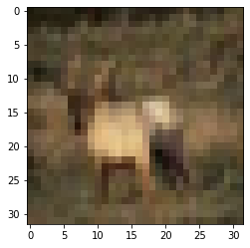
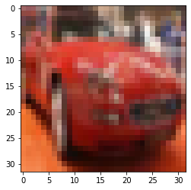
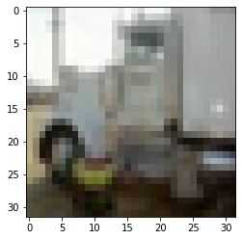
Data/Inputs
Label = 0: “background”
5000
Label = 1: “car”
5000
Label = 2: “truck”
5000
Notes:
Kristen
Algorithms are designed to work with numbers (it’s math)

Slide 7
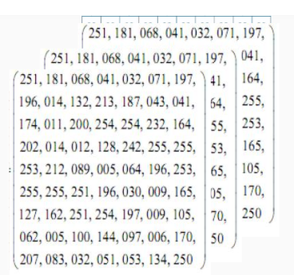
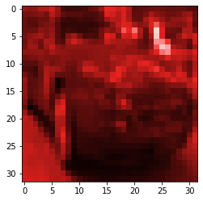
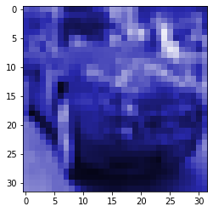
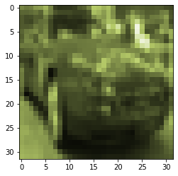
RGB
Notes:
Kristen

Slide 8
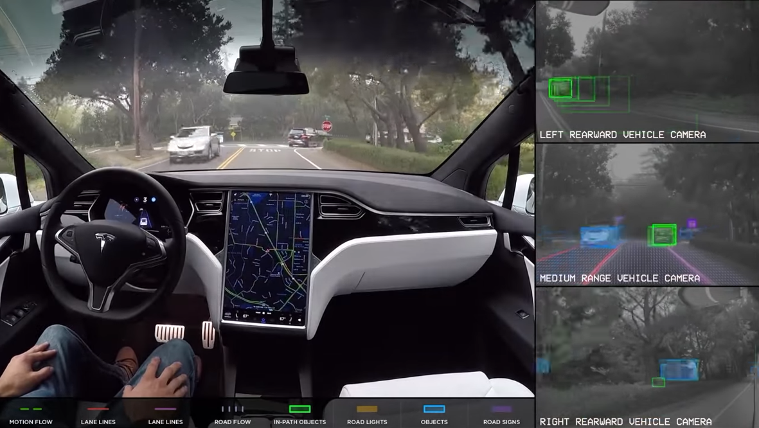
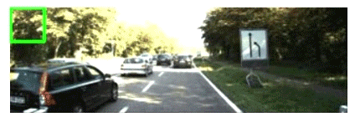

Detection
?
One way:
Sliding Windows
Notes:
Cynthia: Now that we know how to classify our data from a single image, how should we do it for a video, which might have many different objects in it? One way we can do so is by looking at one still frame at a time, and then searching through that still frame to detect what objects appear in it.

Slide 9
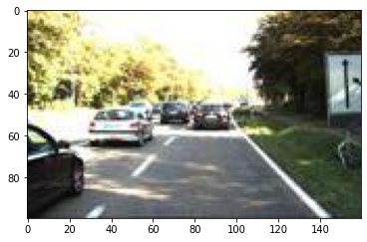
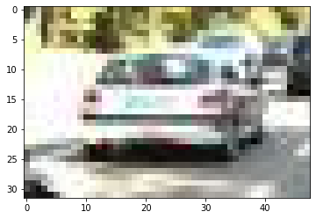
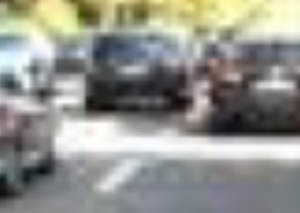
Detecting to Classifying Loops
Car!
…Car?
…
Notes:
Cynthia: For each still frame, we can use a neural network that Kristen spoke about to help us classify the object. But what if the car is not centered, or exactly in the same place as what the Neural Network trained for? We want a model that can recognize a pattern anywhere in the frame. So instead of using a basic neural network, we can use a convolutional neural network, which does a better job at recognizing patterns.

Slide 10

Convolutional Neural Network
Image Source Link
Notes:
Cynthia:

Slide 11

Image Source Link

Slide 12
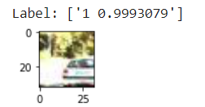
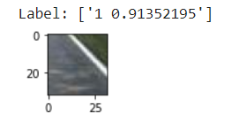
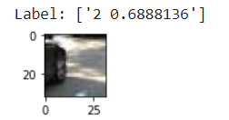
How’d it do?
0 - Background
1 - Car
2 - Truck
Car?
Car?
Truck?
Notes:
Cynthia

Slide 13

You Only Look Once
Notes:
Cynthia: Why we had to resort to an expert model?
We've taught our computer baby how to see and detect, but it needs more experience to be useful. To be able to detect better, we can use grown-up models, or expert models, that have been trained more extensively, on bigger data sets, and with more nuanced models. One of these is YOLO, or you only look once.
YOLO is a deep learning model designed for fast object detection

Slide 14
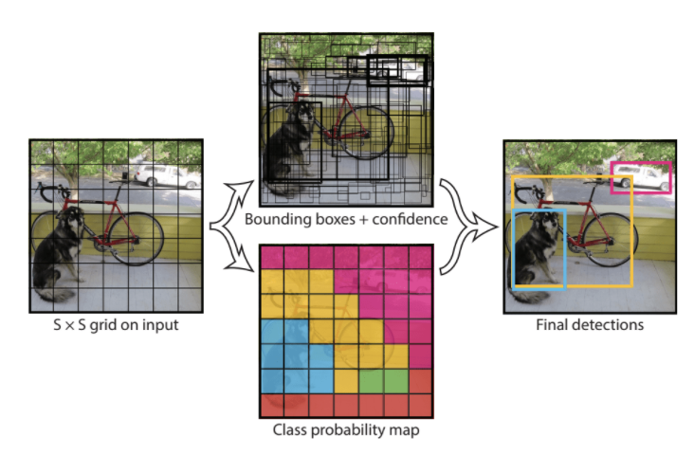
YOLO v3 Visualized
Notes:
Cynthia: Instead of evaluating multiple times across an image like other classifier models, YOLO “looks once” at the whole image, which makes it incredibly fast for object detection in real-time videos. It can do so because it does several things in one forward pass: It splits the image into a grid, then predicts a number of candidate bounding boxes for objects for each cell and creates a class probability map, then combines all the info into a final prediction.

Slide 15
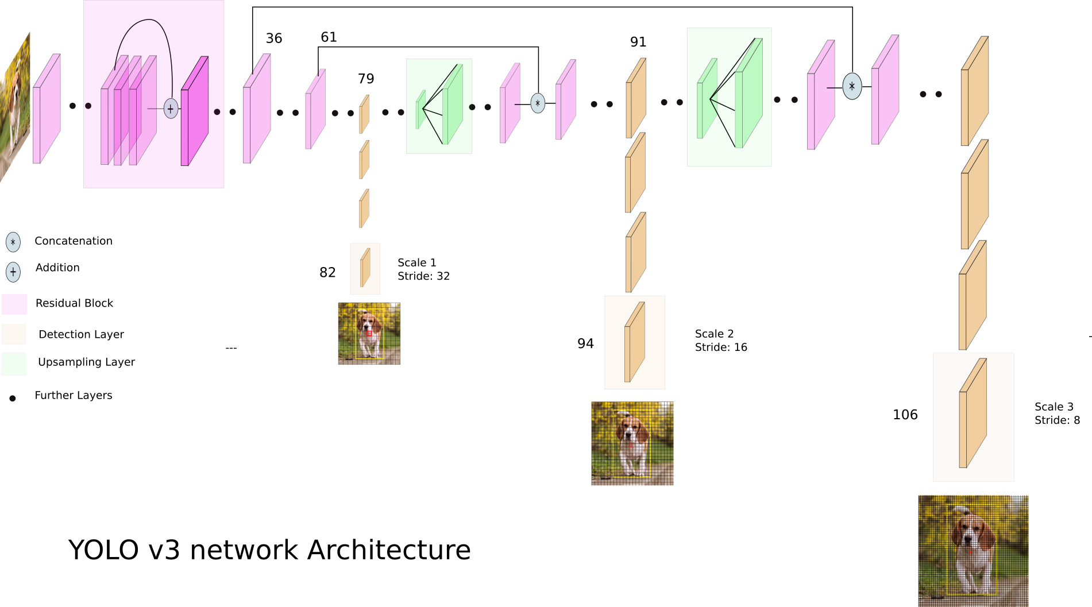
Using an Expert As Basis For Our Model (DarkNet)
Notes:
Max

Slide 16
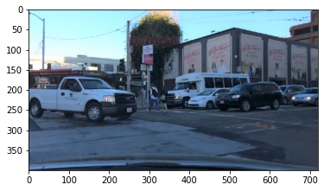
Applying DarkNet To A Static (Singular) Image - 1/2
Notes:
Max

Slide 17
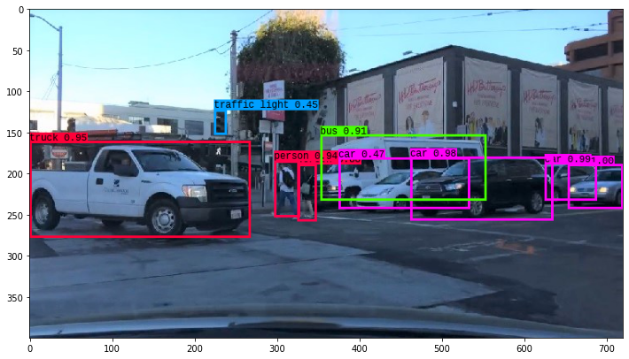
Applying DarkNet To A Static (Singular) Image - 2/2
Notes:
Max

Slide 18
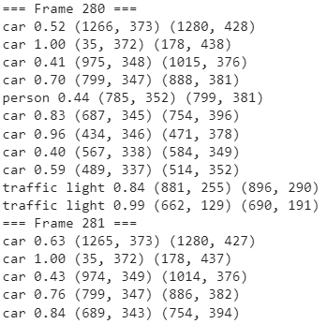
Translating Our Results to Video Feeds
Problem:
Model needs to be able to continuously process dynamic input (video)
Solution:
Break video down into individual frames with specific distance between them
Apply DarkNet for each frame individually
Recompile video with DarkNet overlay
Notes:
Max

Slide 19


Slide 20
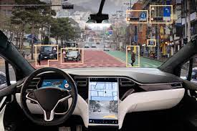
Next Steps
Tuning hyperparameters
Optimizing for longer length clips (speed)
Experimenting with different layer structures (efficiency)

Slide 21
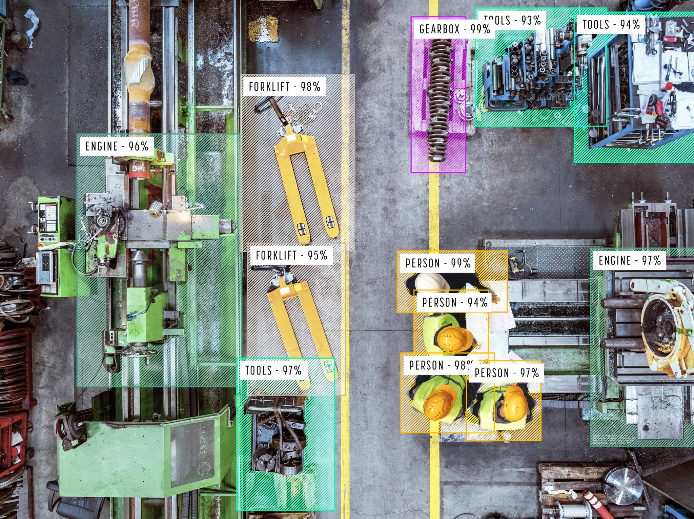
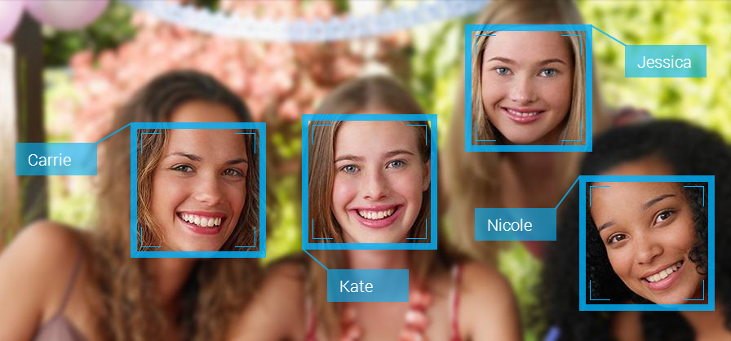

Potential Other Applications
Computer Vision and Object Recognition has many applications:
Factory safety/ progress monitoring
Facial recognition
Supermarket automation of checkout
Autonomous vehicles (drones)
Construction

Slide 22
Thank You For Your Time

